Slide 1
Information Visualization Visualization Sketch
G13-A
83463 – Francisco Campaniço
83482 – João Rafael
83558 – Rodrigo Oliveira

Slide 2
Overview
01

Slide 3
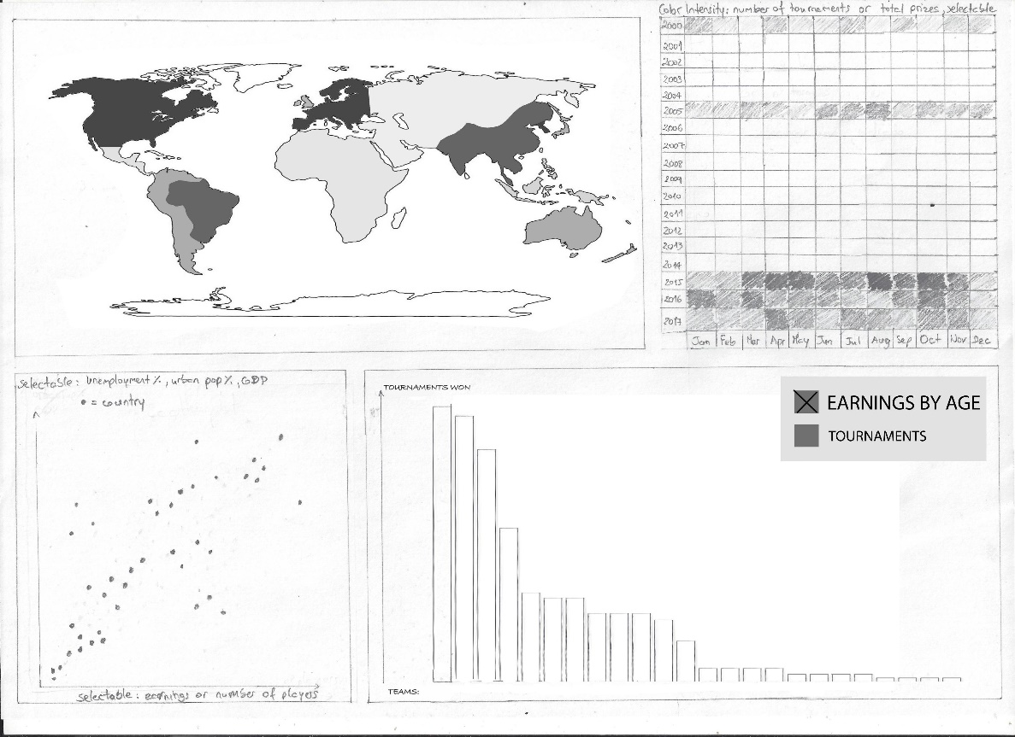
Overview
Choropleth Map:
Scatter plot;
Bar chart;
Dynamic Heat Map:
Bar chart;

Slide 4
Visual encoding
02

Slide 5
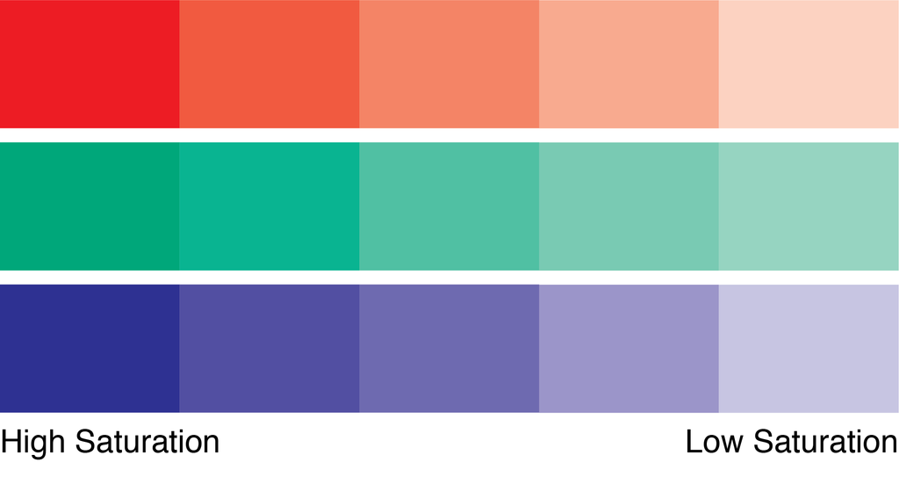
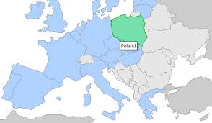
Visual Encoding
Choropleth Map:

Slide 6
Visual Encoding
Scatter plot:
% Unemplyoment
% Urban population
GDP (USD)

Slide 7
Visual Encoding
Bar chart:
Height indicates earnings or quantity of tournaments

Slide 8
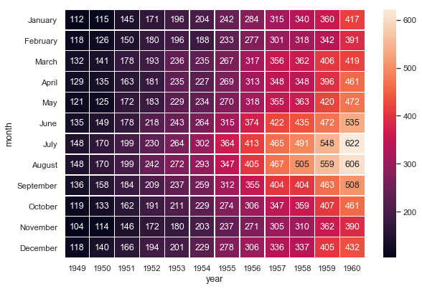
Visual Encoding
Dynamic Heat Map:

Slide 9
IDIOM – tasks/questions mapping
03

Slide 10
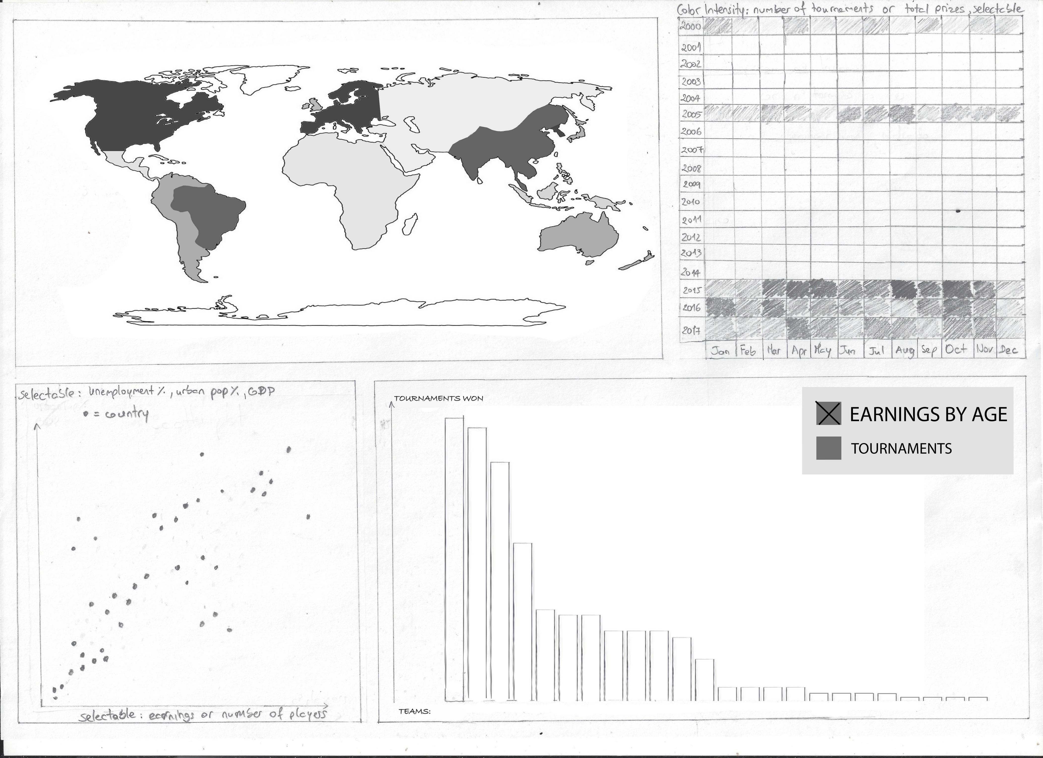
Choropleth Map
What countries have the highest earnings?

Slide 11
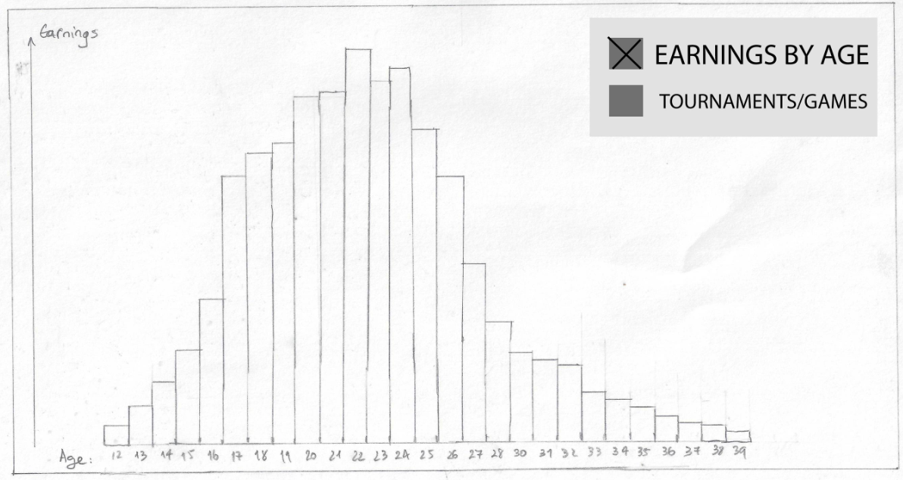
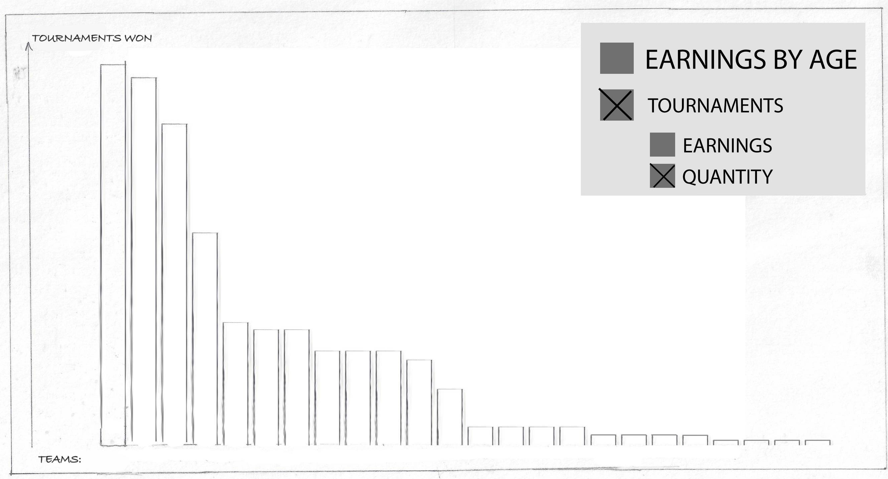
Bar Chart
What organizations earned the most?
What is the age at which players earn the most?
What games have the most earnings?

Slide 12
Scatter plot
How does unemployment correlate with player earnings?

Slide 13
Heat Map
What months are the most active in esports?

